Slide 1


Functional programming in concurrent and distributed systems
381-1-0112 | SM B 2017 | Tutorial 8
David Leon

Slide 2
Outline
Motivation
Links
Example
Monitors
Example
RPC
Example
More about RPC
Submission Procedures

Slide 3
#1 Motivation
Examined system: Logger
A process that receives messages upon occurrence of specified events
Process “logger”
For some of the received messages, another process is notified to show a message on screen
Process “printer”
Process “printer” is spawned by “logger” when it starts
Upon an occurrence of an error in “logger”, a new process is created to handle the log messages
What problem may occur in system?
Multiple “printer” processes may be created and left unused

Slide 4

#2 Links
There may be a dependency between running processes
An error in a process may trigger a series of errors in other processes
Letting them die and restarting the whole group may be an acceptable alternative
What is a link?
A bidirectional relationship that can be created between two processes
If one of the linked processes dies from an unexpected throw, error or exit, the other linked process also dies
How to set or remove a link?
Using BIFs link/1 or spawn_link/1-3 and unlink/1
Both functions receive the linked PID as an argument

Slide 5
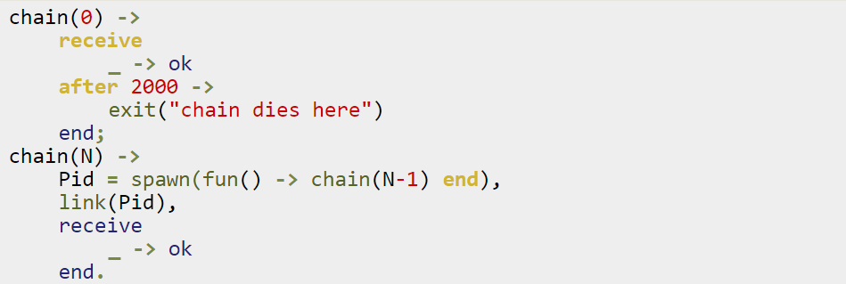
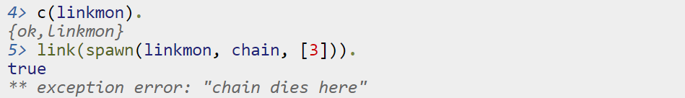
#2.1 Links: Example
Calling and linking chain/1 in the shell:

Slide 6
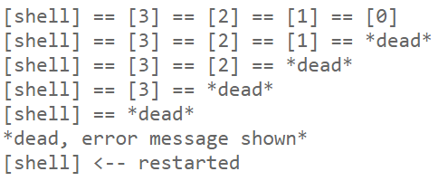
#2.1 Links: Example
What has happened?

Slide 7
#3 Monitors
What if processes does not have to die when another process dies?
When a process only wants to know what's going on with a second process
When neither of the processes really are vital to each other
What is a monitor?
A unidirectional relationship between two processes
If a monitored process goes down, the monitoring process is notified by a message
Can be used also to monitor changes in time offset between Erlang machines
How to set or remove a monitor?
Using BIFs monitor/2 or spawn_monitor/1,3 and demonitor/1,2

Slide 8
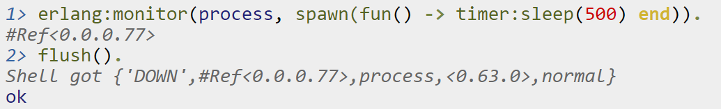
#3.1 Monitors: Example
Example of using monitor/2
Tag
‘DOWN’
‘CHANGE’
MonitorRef
Monitoring relationship identifier
Type
process →
time_offset →
Object
PID →
RegisteredName
{RegisteredName, Node}
clock_service →
Info
no proc
noconnection
NewTimeOffset

Slide 9
Monitor
When a process terminates, it always terminates with an exit reason. The reason can be any term.
A process is said to terminate normally, if the exit reason is the atom normal. A process with no more code to execute terminates normally.
A process terminates with an exit reason {Reason,Stack} when a run-time error occurs.

Slide 10
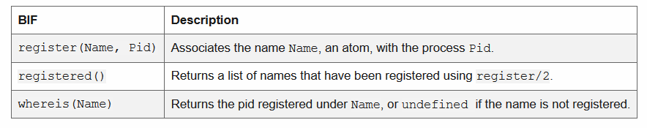
Register
Besides addressing a process by using its pid, there are also BIFs for registering a process under a name. The name must be an atom and is automatically unregistered if the process terminates:

Slide 11
#4 RPC
Remote Procedure Call
Implemented in module rpc
This module contains
Remote procedure calls A method to call a function on a remote node and collect the answer
Broadcast facilities and parallel evaluators
Main uses
Collecting information on a remote node Remote procedure has access to local data in the remote node
Running a function with some specific side effects on the remote node For example, run a process or shut down a running one

Slide 12

#4.1 RPC: Example
Caller Callee
Start
doing
something
Start
doing
something

Slide 13
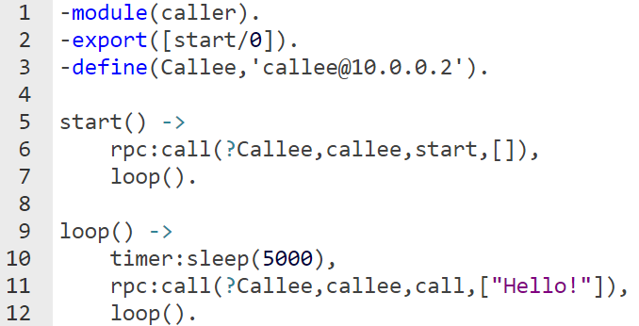
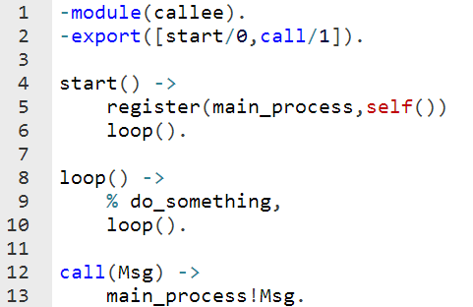
#4.1 RPC: Example
Caller Callee
caller@10.0.0.1 callee@10.0.0.2
RPC
Program flow
Messaging

Slide 14
#4.2 More About RPC
Things to remember before RPC-ing
Upon calling rpc:call/1, system is in blocking point
The receiving process must be registered
Implement call/1 in every host that may receive a rpc call
call/1 does NOT need to handle the received messages
It should be minimal, efficient
You must compile the modules you may call to in the remote host in advance
Starting a terminal would be a bit different from now on:
erl –setcookie secretkey –name name@ipAddress
secretkey – secret atom to connect remotely. Must be identical in both hosts
name – identifier of specific Erlang machine in a host
ipAddress – host’s local IP address

Slide 15
#5 Submission Procedures
Only a single .erl file to be submitted
Filename format: ex8_<ID>.erl
Where <ID> needs to be replaced with your ID number
Your code MUST be well documented
Functions’ names must be identical to the ones defined in exercise
Same as for the arity
Same as for the output format
Only the tested functions needs to be exported
Internal functions MUST NOT be exported
Assignments will be tested automatically in using Erlang shell in Linux
No excuses

Slide 16
Exercise 8
startChat(‘name@IP’)
A chat tool that sends messages between two hosts
Uses rpc module for sending messages
Returns a PID of a local process to send messages to
Spawns a process in ‘name@IP’ if there is no such process yet only
Messages will be then sent by this process to the receiving process in ‘name@IP’
Upon a receive of a message, it should be printed to screen with system time
Upon a receive of a messages stat, prints the number of received/sent messages
Upon a receive of a message quit, kills the program immediately (the remote, too)
You may export any function that is needed to be called on remote host’s module.

Slide 17
Exercise 8
steadyLink(F)
Spawns a process to evaluate function F/0
Links the two processes
Terminates after 5 seconds if no exception occurs
Returns the PID of spawned process
steadyMon(F)
Spawns a process to evaluate function F/0
Monitors the spawned process
Returns the PID of spawned process
Catches any type of termination of F/0 and returns the corresponding result (string)
“Normal termination of process 0.24.0 was detected”
“An exception in process 0.24.0 was detected: <ExceptionType>”
<ExceptionType> is one of the following: error, exit or throw
Terminates after 5 seconds and kills the spawned process.

